Slide 1

AIMS 2024 Gaussian Processes and Active Learning
Austin McDannald
Austin.McDannald@NIST.gov

Slide 2
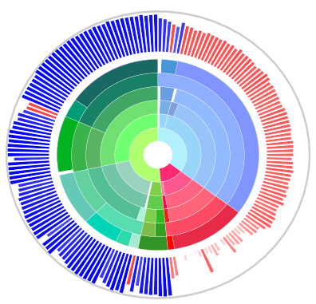


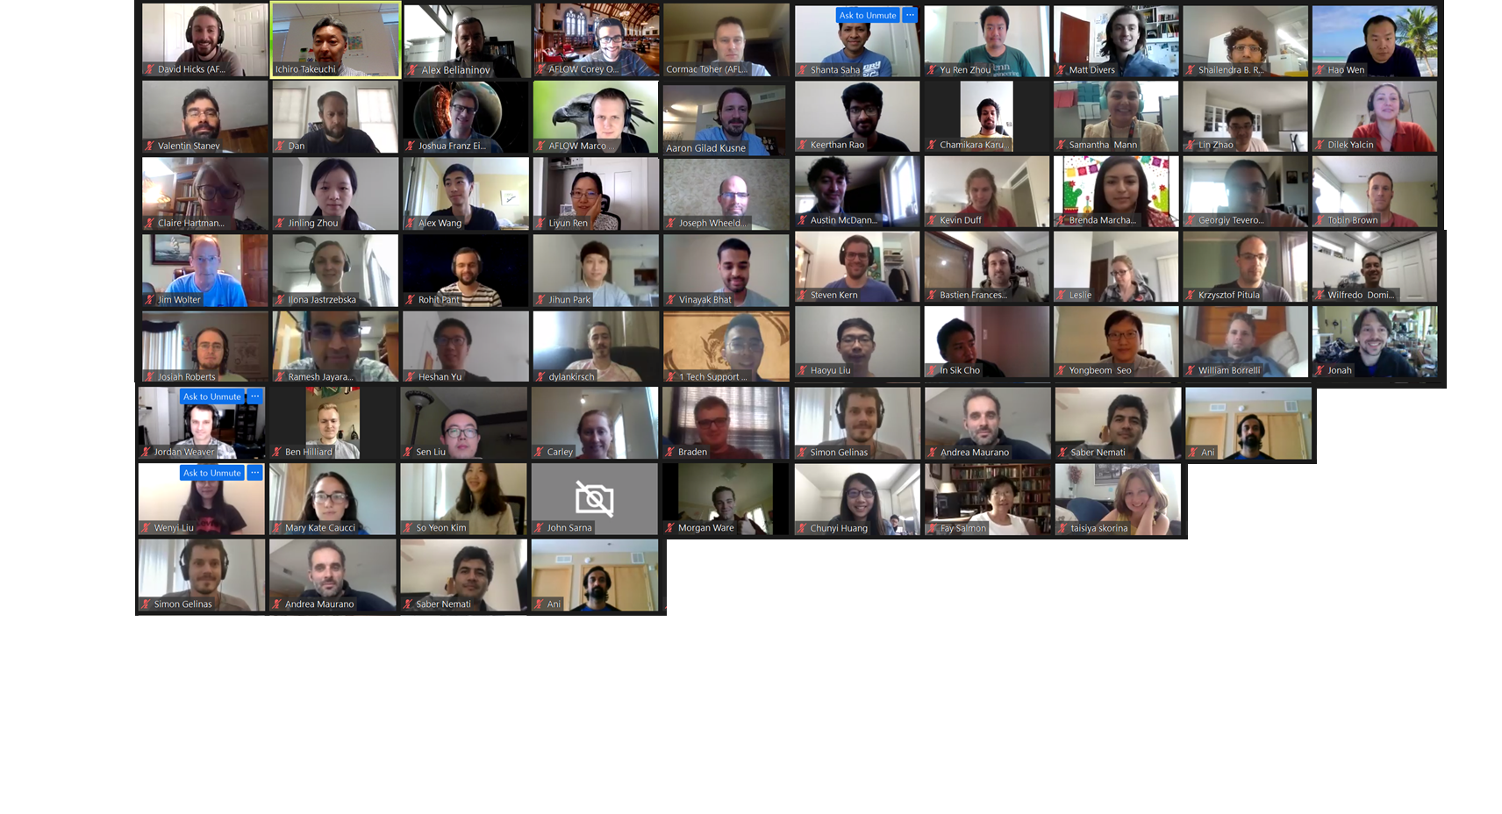
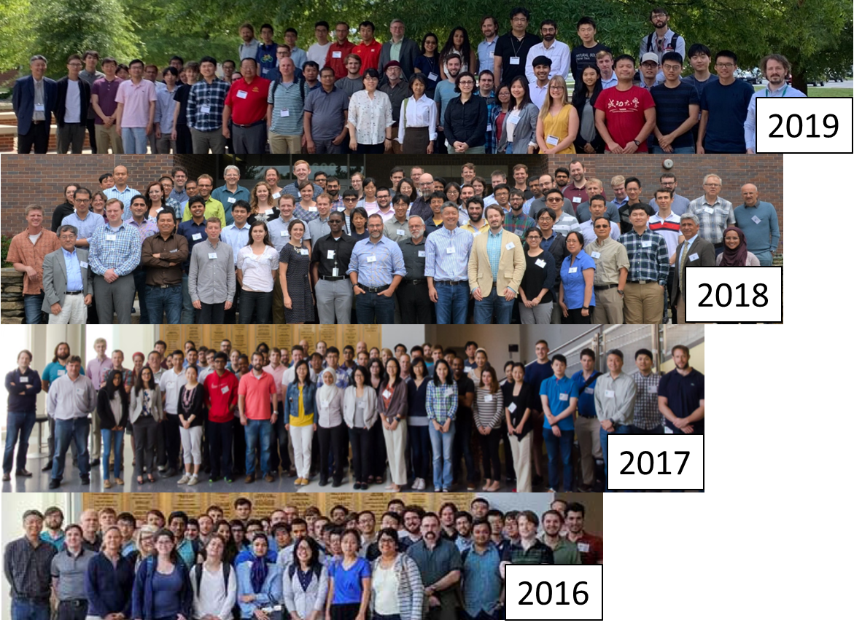
Annual Machine Learning for Materials Research Boot Camp and Workshop
Date: July 22-25 2024
Location: Online
Hybrid, ~200 attendees!
2020
Introduce researchers from industry, national labs, and academia to ML theory and tools for rapid data analysis.
- 4 days of lectures and hands-on exercises (e.g. noise reduction, unsupervised and supervised techniques, computer vision, etc.) includes ML for robot science!
Focus on handling real data, both experimental and computational.
Open-source, Python-based modules
Symposium on Friday
https://umd-mse.catalog.instructure.com/courses/mlmr-2024
Contact: aaron.kusne@nist.gov
Notes:
High throughput ARPES

Slide 3
To the Gaussian Process Colab Notebook! https://tinyurl.com/3db88ka5
https://github.com/mannodiarun/mrs_spring_tutorial/tree/GP_and_AL
3

Slide 4
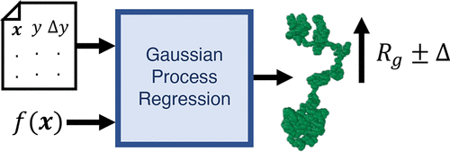
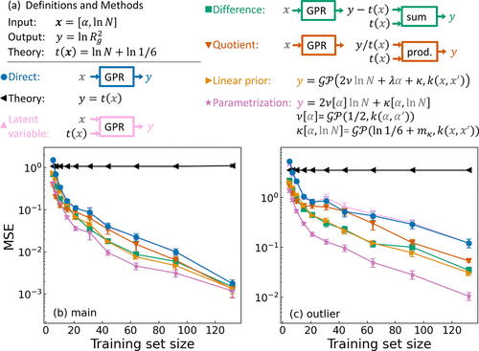
Leveraging Theory for Enhanced Machine Learning
Goal: Predict the Radius of Gyration (R_{g}) of a single polymer chain given the chain length and solvent quality.
Need computationally expensive molecular dynamics (MD) simulations to calculate R_{g}.
Used GPR with different methods for encoding theory to interpolate and extrapolate from the MD simulations with propagated uncertainty.
D. J. Audus, A. McDannald, B. DeCost ACS Macro Lett. 2022, 11, 9, 1117–1122
https://doi.org/10.1021/acsmacrolett.2c00369
4

Slide 5
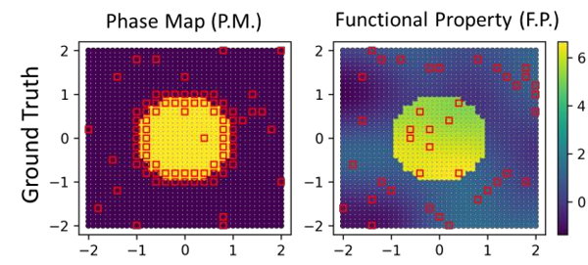
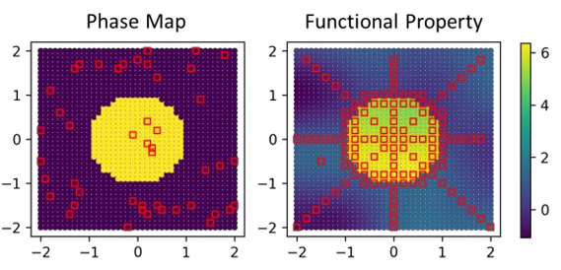
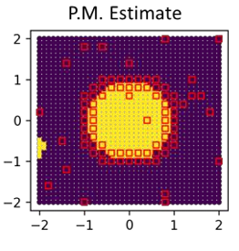
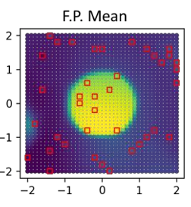
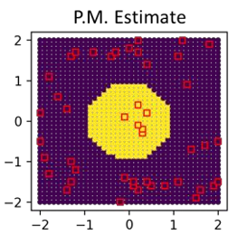
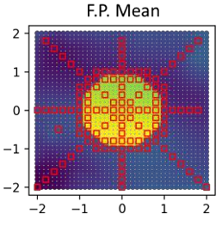
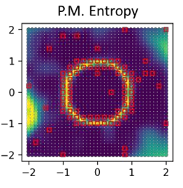
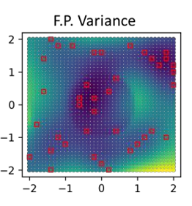
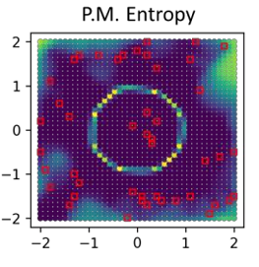
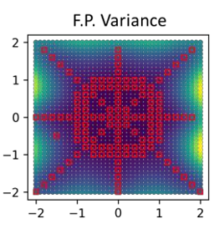
Joint Inference
Lots of data of Phase Map
Not much data on Property
Not much data of Phase Map
Lots of data on Property
Phase Map and Functional Property are Co-Regionalized
Joint inference:
data on one informs the other
SAGE:
arXiv:2311.06228
5

Slide 6
To the Active Learning Colab Notebook! https://tinyurl.com/2zu9n7aj
https://github.com/mannodiarun/mrs_spring_tutorial/tree/GP_and_AL
6

Slide 7
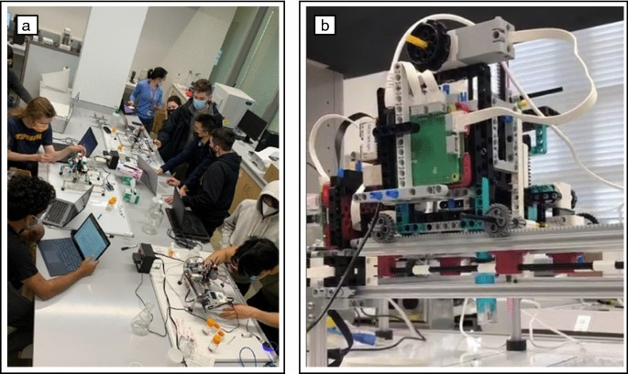
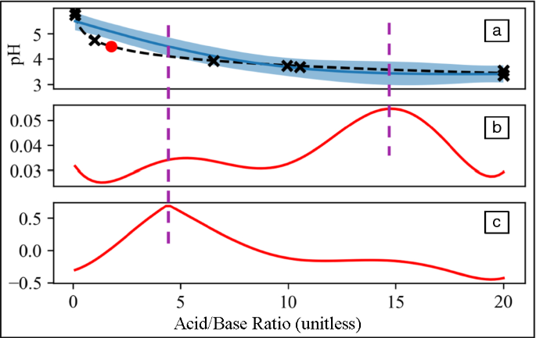
A low-cost robot science kit for education
Saar, L., Liang, H., Wang, A. et al. MRS Bulletin 47, 881–885 (2022).
https://doi.org/10.1557/s43577-022-00430-2
7

Slide 8
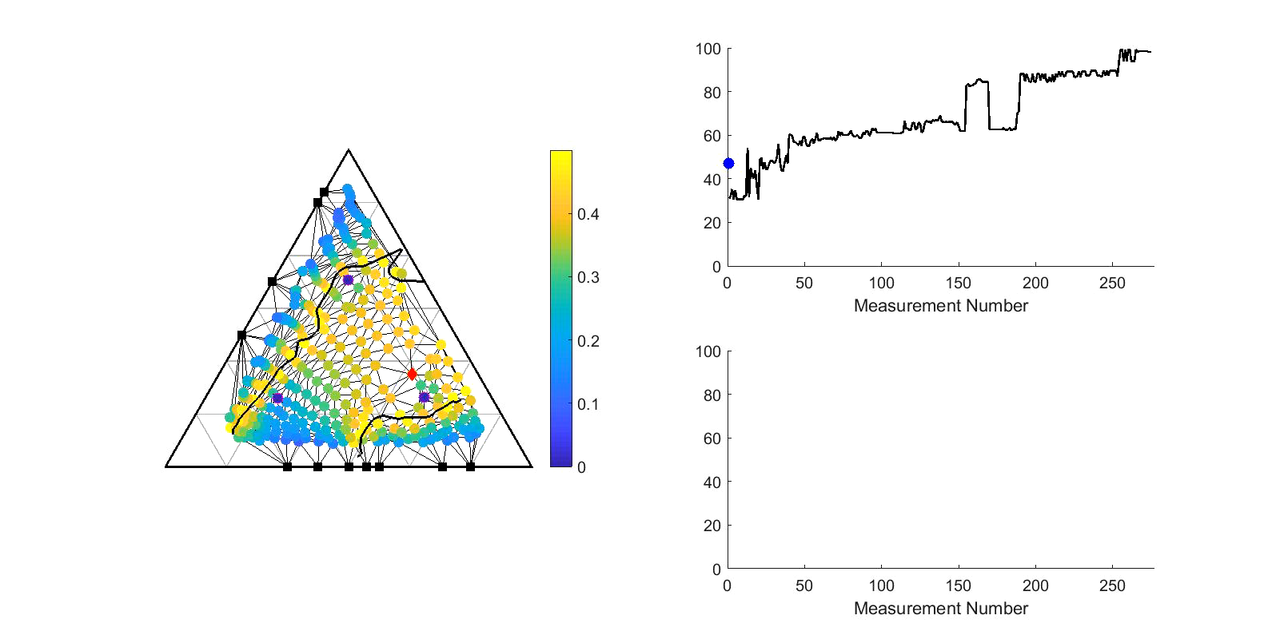
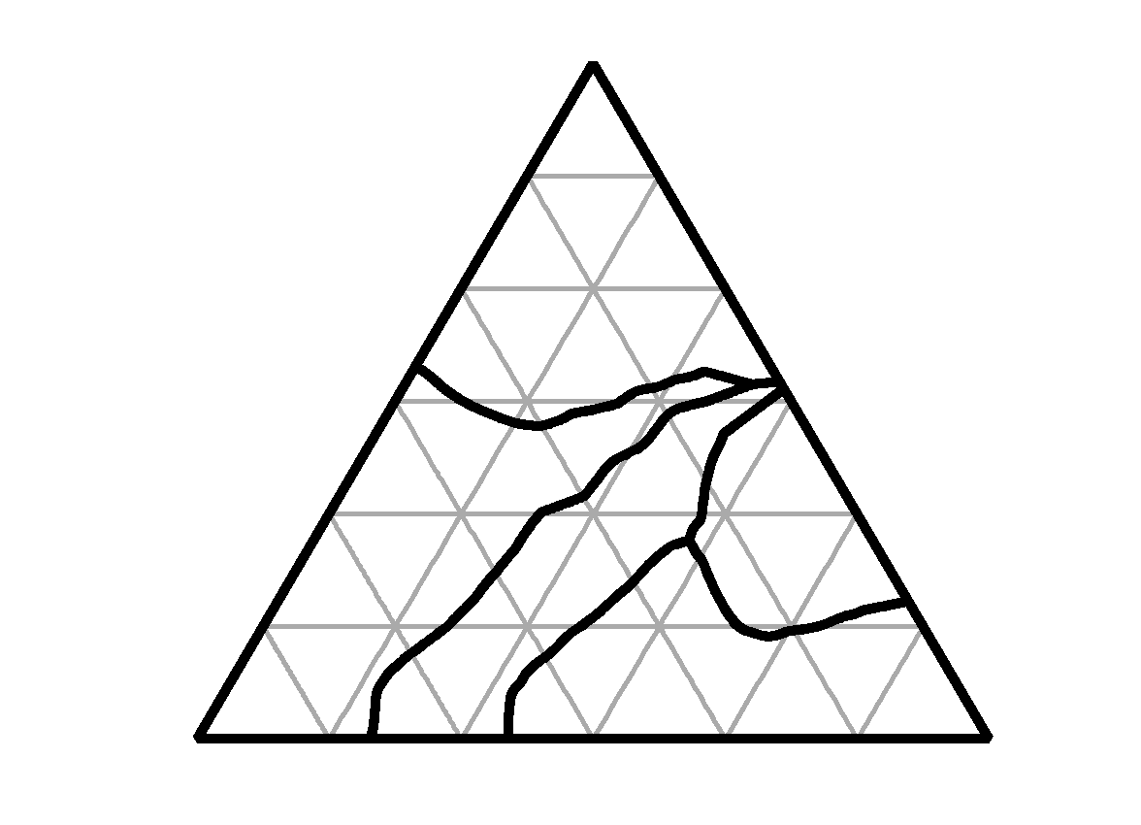
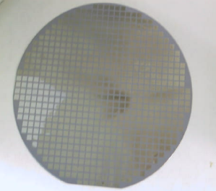
Autonomous Phase Mapping
Fe_{0.4}Pd_{0.6}
Estimated phase boundary
Theory-based sample
Query
Measured samples
Autonomous F-score
Sequential F-score
Misclassification Probability
Fe_{0.4}Pd_{0.6}
Fe
Fe_{0.4}Ga_{0.6}
Fe
Fe_{0.4}Ga_{0.6}
AI is controlling X-ray diffraction systems at SLAC & in the lab!
8

Slide 9
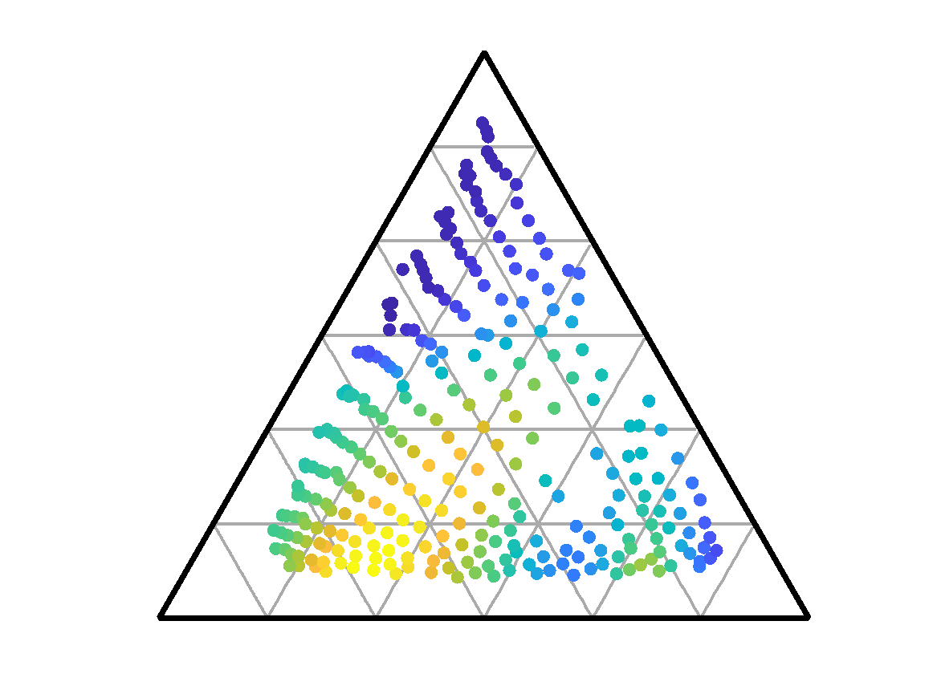
Phase Diagram + Functional Property Optimization
Crystal structure impacts functional properties.
Exploit phase diagram to hone in on optimal materials.
At each iteration, measure XRD and Functional Property
Remnant Magnetization
Fe_{0.4}Pd_{0.6}
Fe
Fe_{0.4}Ga_{0.6}
9

Slide 10
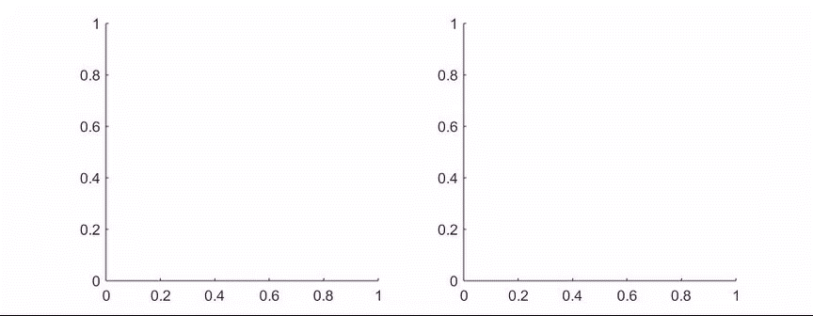
Functional Property Optimization - Phase Map Informed
At every measurement Collect XRD and Magnetization
Fe_{0.4}Pd_{0.6}
UCB
Minimum Regret
Fe
Fe_{0.4}Ga_{0.6}
Random Sampling
# of samples measured
10

Slide 11
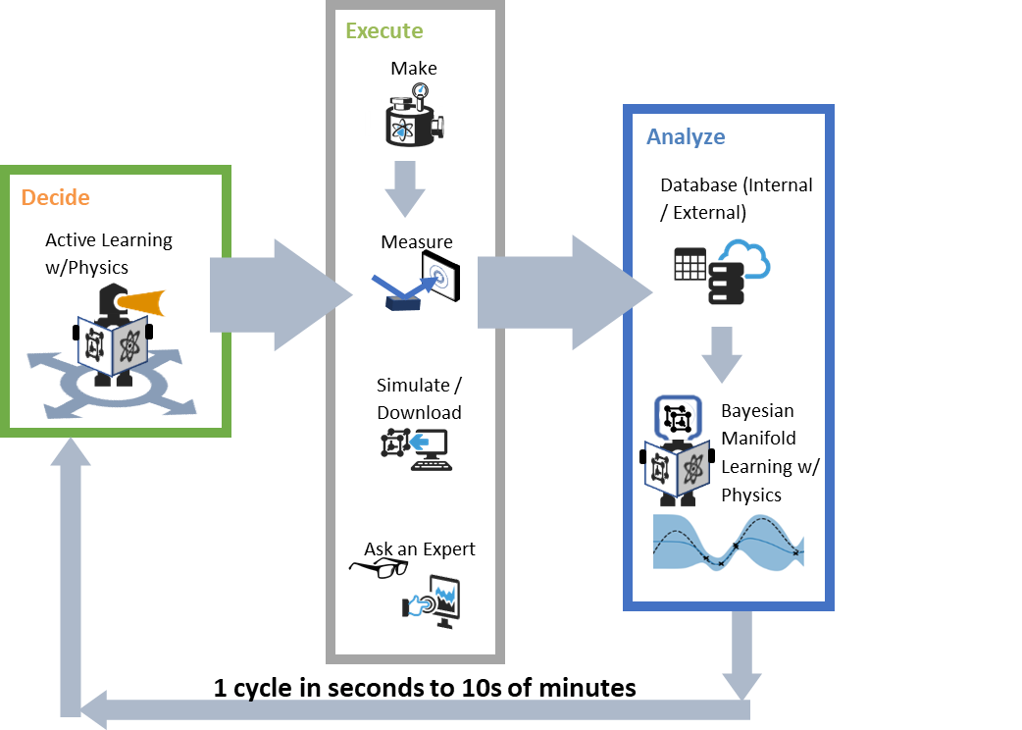
CAMEO: Closed-Loop Autonomous Materials Exploration and Optimization
Improved Speed & Accuracy:
Optimal experiment design
Encoded prior knowledge
Access to external/internal DBs
Instrument control
Interpretability + Uncertainty
Bayesian method
Visualizations
Kusne, et al. "On-the-fly closed-loop materials discovery via Bayesian active learning." Nature Communications 11.1 (2020)
11

Slide 12
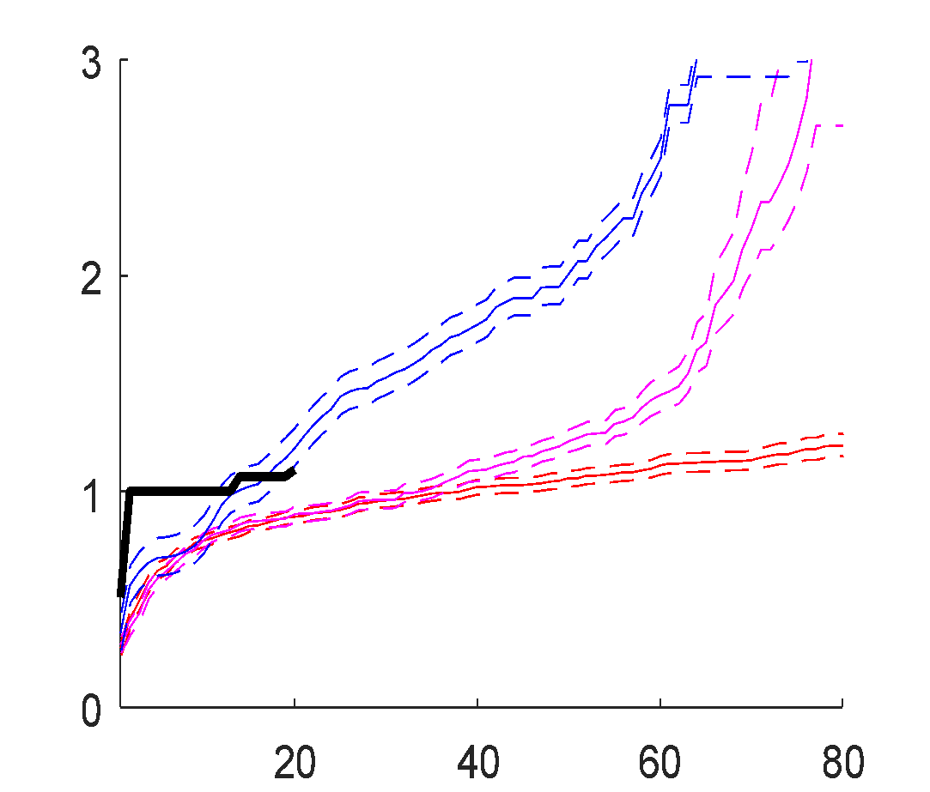
CAMEO: Find best phase change material
Material Optimization: Ge-Sb-Te
10x faster Exploration & Discovery
New material discovered.
Novel nanocomposite phase change memory material
Superior to previous best material.
0.1
0%
AL with prior
+ UCB
1
UCB
Percent Deviation from Optimal [%]
10
Random
100
Kusne, et al. "On-the-fly closed-loop materials discovery via Bayesian active learning." Nature Communications 11.1 (2020)
Iteration Number
12

Slide 13
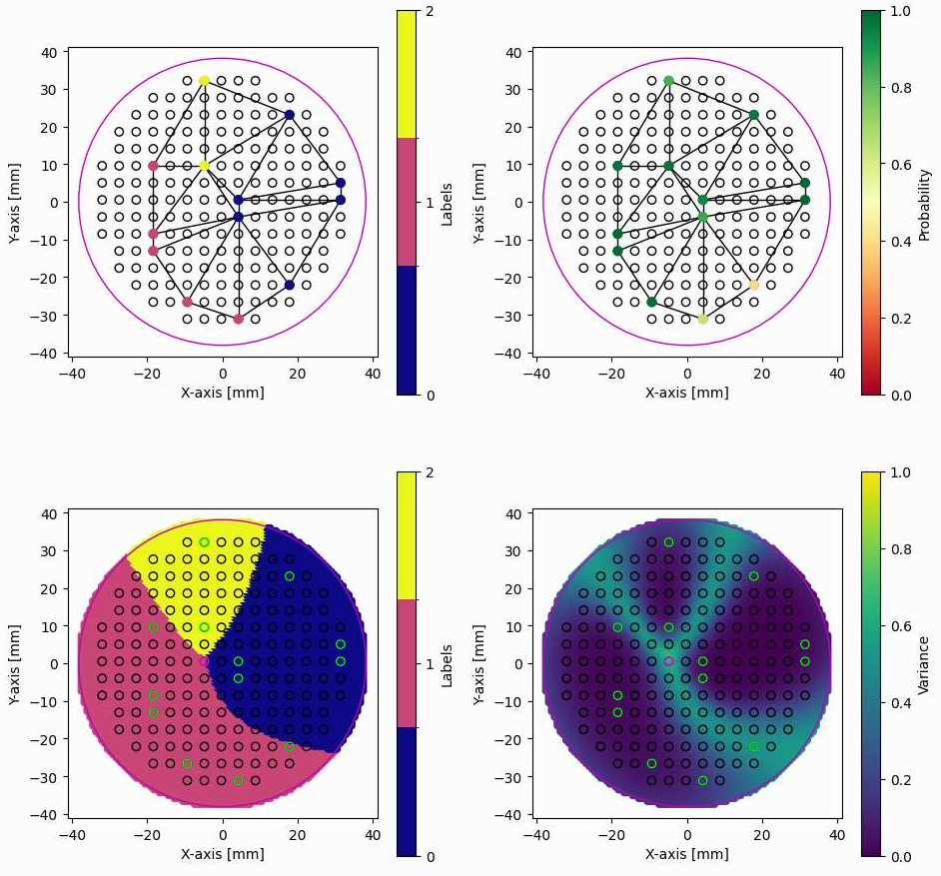
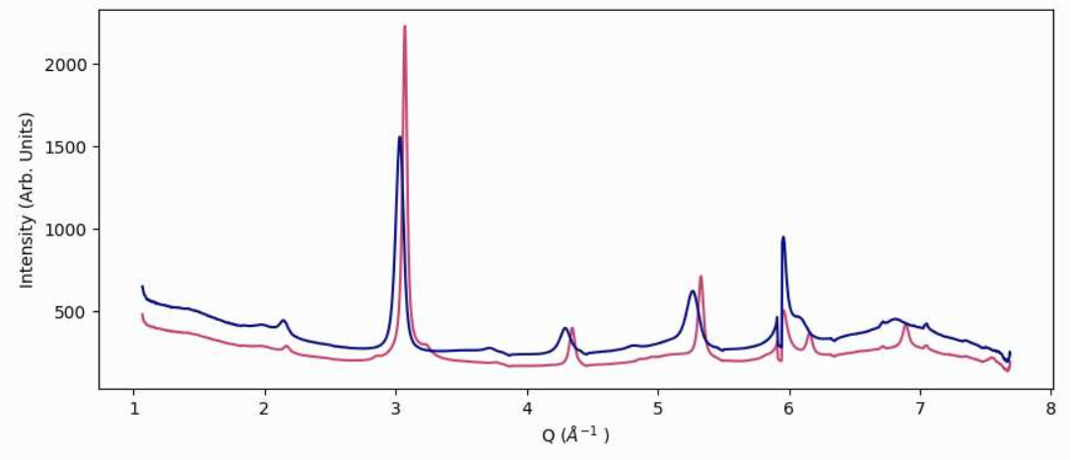
Combi Phase Mapping
Autonomous Phase Mapping with XRD at CHESS
Probabilistically
Take XRD measurements
With
Uncertainty
Propagation
Graph Cut Partitioning
Predict across the whole domain
Choose Next Measurement
13
Notes:
A snapshot of the workflow used to run an autonomous phase mapping campaign at CHESS

Slide 14

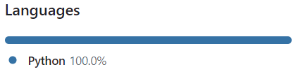
Hermes: Scientific AI
Motivation:
Off-the-shelf ML algorithms – Don’t account for physics
Hermes – Repository of ML for Mat. Sci
Convenient Construction of Autonomous Workflows
Example:
XRD Phase Mapping of Combi wafer
Domain could be:
Phase Mapping: Contiguous Constraint
A
A
Phase regions must
be connected
A
A
A
B
C
C
B
C
B
Hermes: easily work & translate between domains
C
B
C
B
EBSD Grain Mapping
Same Contiguous Constraint
14

Slide 15

Hermes:
Code repository for autonomous systems.
Fork us on GitHub
https://github.com/usnistgov/hermes/tree/main
Questions?
15

Slide 16
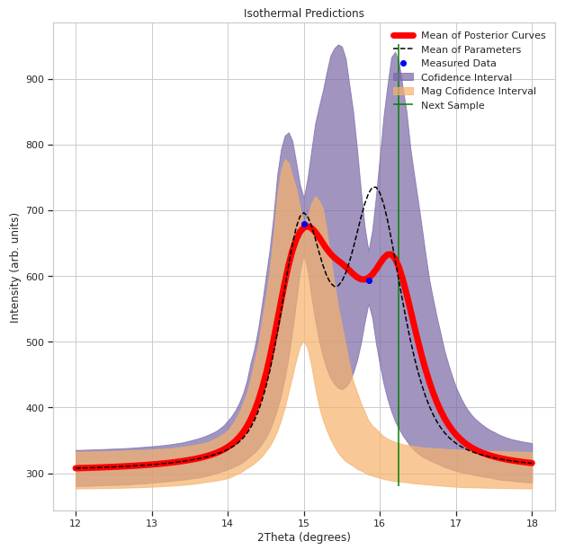
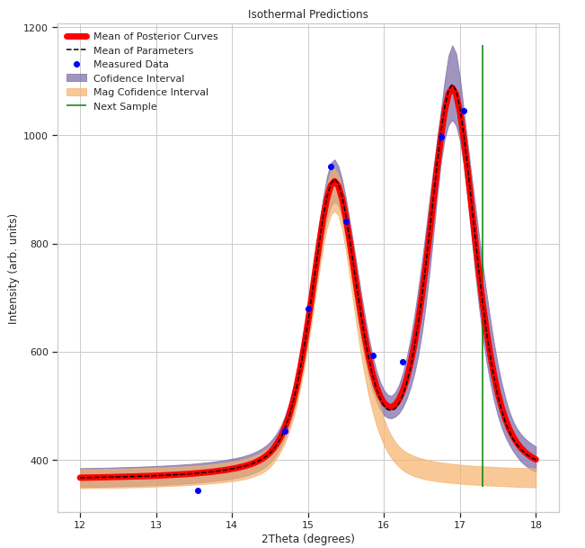
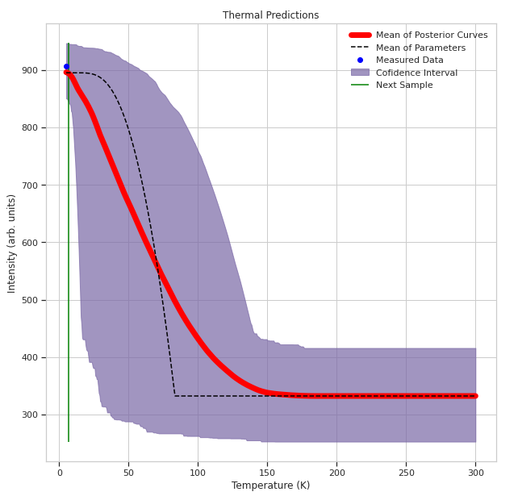
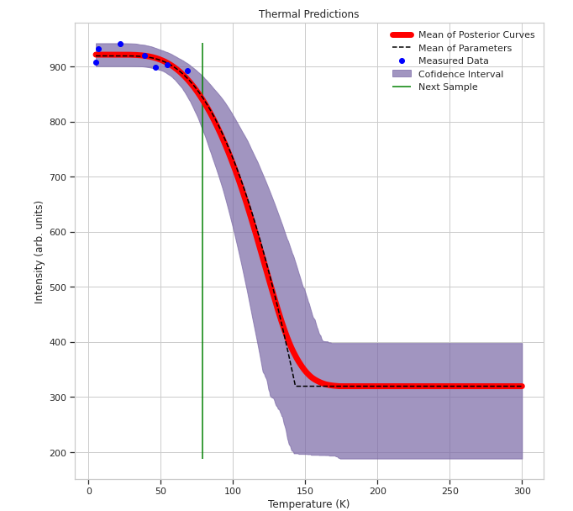
Autonomous Neutron Scattering: Superconductors
Autonomous control: 2Theta and Temperature
Austin McDannald
Peak Parameters
Neel Temperature
Peak Intensity
Temperature

